Slide 1
Is Part-Aware DM-GAN Better?
Final Project · CUB-200-2011 · Group G_
Controlled answer: superiority was not demonstrated.
BASELINE
TARGET
DESIGN
VERDICT
Credible
Part–colour
Paired
Not shown
30k author-weight reproduction
Output-level swap accuracy
Same start, data, noise, budget
Proxy moved; output did not
Wenzhe Cao · Jikui Zhou · Xinyi Jiang · Zhongyu Yin
1 / 15
Notes:
Open with the research question and answer it immediately. The part-aware loss changed its internal attention proxy slightly, but it did not improve the output-level target metric. ‘Not demonstrated’ does not mean ‘proved impossible.’
[Sources]
Local final experiment: /home/zjk/Desktop/DM-GANS/artifacts/session7/ablation/report.json

Slide 2
01
When Can C Be Called Better Than B?
A narrow rule set fixed before reading the results
Target Improvement
Global Safeguards
Primary metric Part–colour swap accuracy: C − B with a cluster-bootstrap 95% CI above zero. Consistency Positive direction in at least 2 of 3 paired seeds.
FID Regression no worse than +1.0. R-precision Loss no worse than −1.0 percentage point. Observed verdict NOT DEMONSTRATED
2 / 15
Notes:
Explain that the rule prevents a claim based only on an optimized internal loss. The target metric needed a confidence interval above zero, global quality had to stay within the safeguards, and at least two seeds had to agree.
[Sources]
Decision criteria: /home/zjk/Desktop/DM-GANS/artifacts/session7/ablation/report.json

Slide 3
02
DM-GAN Is Strong Globally—but Parts Can Drift
Dynamic memory refines a weak first image with word features
Core Pipeline
Key Tension
Caption + z
→
64×64 sketch
→
Memory-guided 128×128 / 256×256
The model can capture overall bird colour while placing eye, crown, wing, belly, or beak attributes ambiguously.
At each refinement scale, current image features query a rewritten word memory.
Why Test Part Awareness
Global realism and text match do not guarantee correct part placement. The proposed loss targets internal attention, so output evidence is still required.
3 / 15
Notes:
DM-GAN first creates a low-resolution image and then uses dynamic word memory at higher resolutions. Global colour can look plausible while a specific part relationship remains ambiguous. This motivates the test; it is not itself quantitative evidence.
[Sources]
DM-GAN paper: https://openaccess.thecvf.com/content_CVPR_2019/html/Zhu_DM-GAN_Dynamic_Memory_Generative_Adversarial_Networks_for_Text-To-Image_Synthesis_CVPR_2019_paper.html
Local failure analysis: /home/zjk/Desktop/DM-GANS/docs/failure_analysis.md

Slide 4
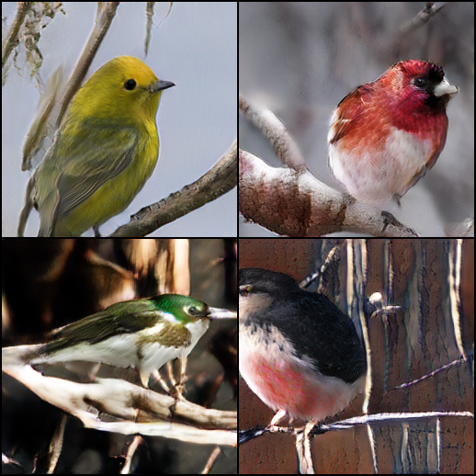
03
The Reproduced Baseline Is Credible
Author weights · modern inference/evaluation path · 30,000 fixed samples
EVAL · SCALE
FID · LOWER
R-PRECISION · HIGHER
30,000
15.76
76.67%
fixed test samples
released ref. 15.34
released ref. 76.58%
Official checkpoint · local inference
Released and Local Results
PASS Comparable FID and R-precision validate checkpoint compatibility, generation, and evaluation. This does not prove that the 200-step random-init run converged.
Released R-precision
76.58% ±0.53
Released PyTorch FID
15.34
Local R-precision
76.67% ±0.83
Local PyTorch FID
15.76
4 / 15
Notes:
The official generator and DAMSM weights were evaluated through the modern code path on 30,000 fixed samples. Comparable PyTorch FID and DAMSM R-precision make the baseline reproduction credible. The short random-initialized run was only pipeline evidence.
[Sources]
Baseline evaluation: /home/zjk/Desktop/DM-GANS/artifacts/session6/baseline_evaluation/report.json
Official performance: https://github.com/MinfengZhu/DM-GAN#performance

Slide 5
04
Part-Aware Loss Guides Attention Toward Landmarks
Extra CUB supervision is added only to branch C
Build Supervision
Align Attention
1. Transform 15 visible landmarks with the image 2. Merge left/right eye, wing and leg when side-neutral 3. Convert target parts to Gaussian heatmaps
Map part nouns and nearby colour words to targets Compute cross-entropy at 128 and 256 Ltotal = LDM-GAN + 0.05 Lpart
Important Boundary
The loss supervises internal word attention—not final pixels. Output-level evaluation must still decide whether the image is better.
5 / 15
Notes:
The loss converts visible CUB landmarks into Gaussian maps, maps part-related tokens to those maps, and penalizes attention away from the target at the 128 and 256 stages. Gaussian sigma is 8% of map width. Invisible, cropped, and unassigned targets are excluded. This supervises attention, not pixels.
[Sources]
Implementation: /home/zjk/Desktop/DM-GANS/dmgan/part_aware.py
CUB dataset: https://www.vision.caltech.edu/datasets/cub_200_2011/

Slide 6
05
Landmarks Must Follow Every Image Transform
A coordinate mismatch would invalidate the supervision
Synchronized Path
Validity Rules
bbox crop → resize → random crop → horizontal flip → attention grid
Mask invisible or cropped points Flip x-coordinates with the image Merge left/right heatmaps for side-neutral words
If image and landmark transforms diverge, the loss rewards attention at the wrong location. This was the critical data-pipeline change.
6 / 15
Notes:
Coordinate synchronization is the critical construction detail. Landmarks follow bbox crop, resize, random crop, and horizontal flip. Visibility is recomputed after cropping, and side-neutral nouns use merged left/right targets.
[Sources]
Dataset pipeline: /home/zjk/Desktop/DM-GANS/dmgan/data.py
CUB annotation format: /home/zjk/Desktop/DM-GANS/data/birds/CUB_200_2011/README

Slide 7
06
A Is Reference; B versus C Is the Experiment
Only the paired branches isolate the added loss
Three Roles
A · Reference only Untouched released generator B · Baseline control Equal-budget fine-tuning, λpart = 0 C · Part-aware variant Same start and budget, λpart = 0.05
B · Control
λpart = 0
A · Released G
reference only
Shared
D warm-up
C · Part-aware
λpart = 0.05
Only B ↔ C is causal
Valid Contrast
A gives context. B absorbs continued training, the fresh discriminator, and optimizer updates. Only C − B estimates the effect of Lpart.
Shared official G and a 200-step D warm-up feed both branches. The comparison arrow is B ↔ C—not A ↔ C.
7 / 15
Notes:
A is useful only as a reproduction reference. Comparing fine-tuned C with untouched A would mix the loss effect with continued training and discriminator adaptation. B absorbs those effects, so only C minus B is the valid experimental contrast.
[Sources]
Training protocol: /home/zjk/Desktop/DM-GANS/scripts/run_part_aware_ablation.py
Training manifest: /home/zjk/Desktop/DM-GANS/artifacts/session7/ablation/training_manifest.json

Slide 8
07
B and C Received the Same Training Opportunity
Every paired update differed only by the part-aware loss
Shared Start
Locked Training
Official generator 200-step D warm-up per seed Same G, D, and optimizer state Seeds 20260824–20260826
Same batches, captions, crop/flip, z, and RNG Same frozen DAMSM and EMA 1,200 updates · batch 10 G lr 2e−5 · D lr 2e−4
Trainable Scope
Controlled fine-tuning—not a new full 800-epoch training claim.
Same refine_128/refine_256 modules and 128/256 image heads. C alone adds 0.05 Lpart.
8 / 15
Notes:
For each seed, the discriminator was warmed for 200 steps with the generator frozen. The same G, D, optimizer state, batches, caption choices, augmentations, latent noise, and RNG were used for the paired branches. Generator learning rate was 2e-5, discriminator learning rate 2e-4, batch size 10, and each branch ran 1,200 updates. EMA weights were evaluated.
[Sources]
Training script: /home/zjk/Desktop/DM-GANS/scripts/run_part_aware_ablation.py
Seed protocol: /home/zjk/Desktop/DM-GANS/artifacts/session7/ablation/seed_20260824/training_report.json

Slide 9
08
One Fixed Evaluation Tests Target and Safeguards
30,000 paired generations · same captions, noise, negatives
Targeted Test
Global + Mechanism
Part–colour swap accuracy Correct caption vs 9 colour-swapped alternatives The colour-swap protocol contained 24,454 eligible captions. After deterministic caption repetition for the 30,000-sample evaluation, 24,924 evaluation rows per model were eligible for the part-colour metric. Higher is better
FID · realism/diversity · lower better R-precision · text match · higher better Attention CE + support mass · mechanism proxy 28,555 active attention cases
Paired Protocol
DAMSM scoring is useful, but it is not independent human validation.
Evaluation seed 20260902 · same 29,330-caption bank (670 wrap once) · cluster by image key
9 / 15
Notes:
The colour-swap test keeps the part noun fixed and replaces only the colour word. The generated image should rank its correct caption above nine alternatives. FID is the realism/diversity safeguard and R-precision is the text-match safeguard. The same frozen DAMSM family scores the targeted test, so this is not independent human validation.
[Sources]
Evaluator: /home/zjk/Desktop/DM-GANS/scripts/evaluate_ablation.py
Protocol: /home/zjk/Desktop/DM-GANS/artifacts/session7/ablation/colour_swap_protocol.json
FID paper: https://proceedings.neurips.cc/paper/2017/hash/8a1d694707eb0fefe65871369074926d-Abstract.html
DAMSM paper: https://openaccess.thecvf.com/content_cvpr_2018/html/Xu_AttnGAN_Fine-Grained_Text_CVPR_2018_paper.html

Slide 10
09
C Did Not Beat B Consistently Across Seeds
Three paired runs · absolute values shown · deltas are C − B
FID · LOWER IS BETTER
R-PRECISION / PART–COLOUR · HIGHER IS BETTER
R-precision (%)
Part–colour (%)
Across Seeds
Target improved in only 1/3 seeds. FID was slightly worse in 3/3.
Part–colour Δ: +0.04, −0.02, −0.18 pp · FID Δ: +0.014, +0.039, +0.055 · R Δ: −0.07, −0.08, +0.29 pp
10 / 15
Notes:
Read direction before magnitude. Part-colour improves only for seed 20260824 and falls for the other two. FID moves in the wrong direction for all three. R-precision is mixed. The changes are tiny, but the targeted effect is not consistently positive.
[Sources]
Per-seed results: /home/zjk/Desktop/DM-GANS/artifacts/session7/ablation/report.json

Slide 11
10
The Aggregate Target Effect Includes Zero
Statistical uncertainty blocks a positive output-level claim
PART–COLOUR
R-PRECISION
MEAN FID
−0.05 pp
+0.05 pp
+0.036
95% CI [−0.15, +0.05]
95% CI [−0.05, +0.16]
16.054 → 16.090
C − B effects · 95% cluster bootstrap
Aggregate Tests
NOT DEMONSTRATED Part–colour CI crosses zero. FID is worse in every seed, though inside the +1 safeguard. The output-level benefit was not demonstrated.
Part–colour CI
[−0.149, +0.054]
Part–colour
R-precision CI
[−0.049, +0.155]
McNemar · colour
p = 0.327
R-precision
McNemar · R
p = 0.354
11 / 15
Notes:
The part-colour interval crosses zero, so both a tiny benefit and a tiny harm remain compatible with the data. Aggregate McNemar p-values are 0.327 for colour and 0.354 for R-precision. FID has no improvement signal. The output-level benefit was not demonstrated.
[Sources]
Aggregate statistics: /home/zjk/Desktop/DM-GANS/artifacts/session7/ablation/report.json

Slide 12
11
The Proxy Moved; the Output Did Not
Mechanism activation is necessary, but it is not the research outcome
Directly Optimized
Observed Output
Attention CE 11.2554 → 11.2499 Δ −0.0055 · lower is better Annotated-support mass Δ +0.0009 pp
Part–colour Δ −0.05 pp · CI crosses zero FID Δ +0.036 · worse
Interpretation
Gradients reached the intended attention mechanism, but the ~0.05% proxy shift did not transfer to reliable generated-image behaviour.
12 / 15
Notes:
Lower attention CE confirms that gradients reached the intended mechanism, but the relative change is only about 0.05%, and support-mass movement is effectively zero. Because CE is directly optimized, it cannot by itself validate generated-image improvement.
[Sources]
Attention metrics: /home/zjk/Desktop/DM-GANS/artifacts/session7/ablation/report.json

Slide 13
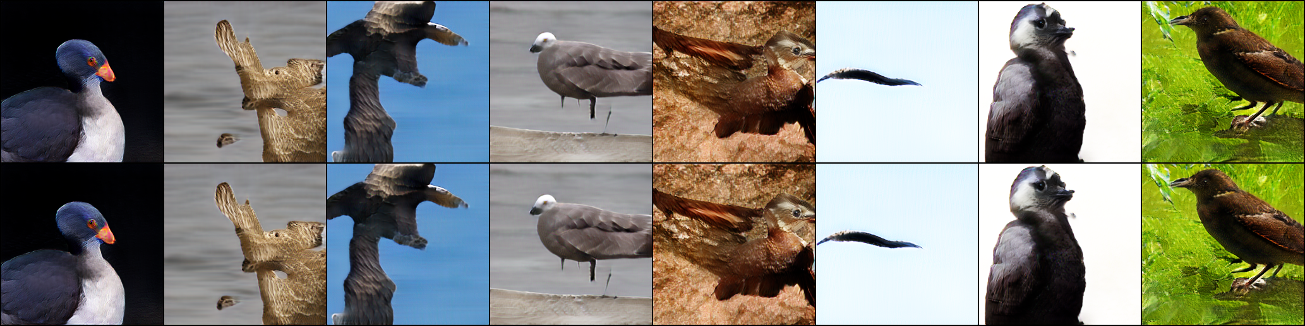
12
Fixed, Unfiltered Pairs Look Mixed
Complete fixed preview · seed 20260824 · B top, C bottom · no cherry-picking
Visual Reading
Differences are subtle: C sometimes looks better, sometimes similar, and sometimes worse. The grid agrees with the mixed metrics.
B = baseline control · C = part-aware variant · full paired grid shown
13 / 15
Notes:
These are the complete first fixed evaluation cases for seed 20260824, not images selected after ranking quality. B is top and C is bottom. Differences are subtle and mixed. Do not infer significance from visual inspection.
[Sources]
Fixed seed 20260824 grid: /home/zjk/Desktop/DM-GANS/artifacts/session7/ablation/seed_20260824/evaluation_preview_baseline_top_part_bottom.png

Slide 14
13
What This Experiment Can and Cannot Establish
A fair fine-tuning test with clear limits
Supported
Not Supported
Fair B-versus-C comparison Part-aware gradients reached attention No reliable output gain under this protocol
Universal failure of part supervision Outcome after full 800-epoch training Direct generated-image keypoint accuracy
Costs and Biases
C uses extra landmark labels; real pose may not match generated pose; DAMSM/token mapping are not independent judges; only 3 seeds and 1,200 updates.
14 / 15
Notes:
The study supports a fair controlled fine-tuning comparison and the statement that no reliable output gain was observed here. It does not establish universal failure, a full-training outcome, or generated-image keypoint accuracy. C also consumes extra landmark labels.
[Sources]
Limitations: /home/zjk/Desktop/DM-GANS/artifacts/session7/ablation/PART_AWARE_ABLATION.md
CUB dataset: https://www.vision.caltech.edu/datasets/cub_200_2011/

Slide 15
14
Final Answer: Not Demonstrated
The mechanism activated, but C did not outperform the fair control
What We Completed
What the Evidence Says
Credible baseline reproduction Working part-aware data + loss path 3 paired seeds 30,000 fixed evaluations per model
Attention proxy: slightly better Part–colour output: no reliable gain FID: slightly worse in all seeds R-precision: essentially unchanged
Next Study
Validated baseline → fair experiment → honest null result
Independent generated-image part detector or blinded human scoring, then longer multi-seed training.
15 / 15
Notes:
Close in one sentence: under three paired seeds and 30,000 fixed evaluations, C did not reliably improve part-colour matching and slightly worsened FID, so superiority is not demonstrated. The next test should use an independent generated-image part detector or blinded human ratings and longer multi-seed training.
[Sources]
Final decision: /home/zjk/Desktop/DM-GANS/artifacts/session7/ablation/report.json

